Slide 1
Hongjun Yun

Slide 2
Location
5 Forewell Road, Kitchener, ON N2B 1W3

Slide 3
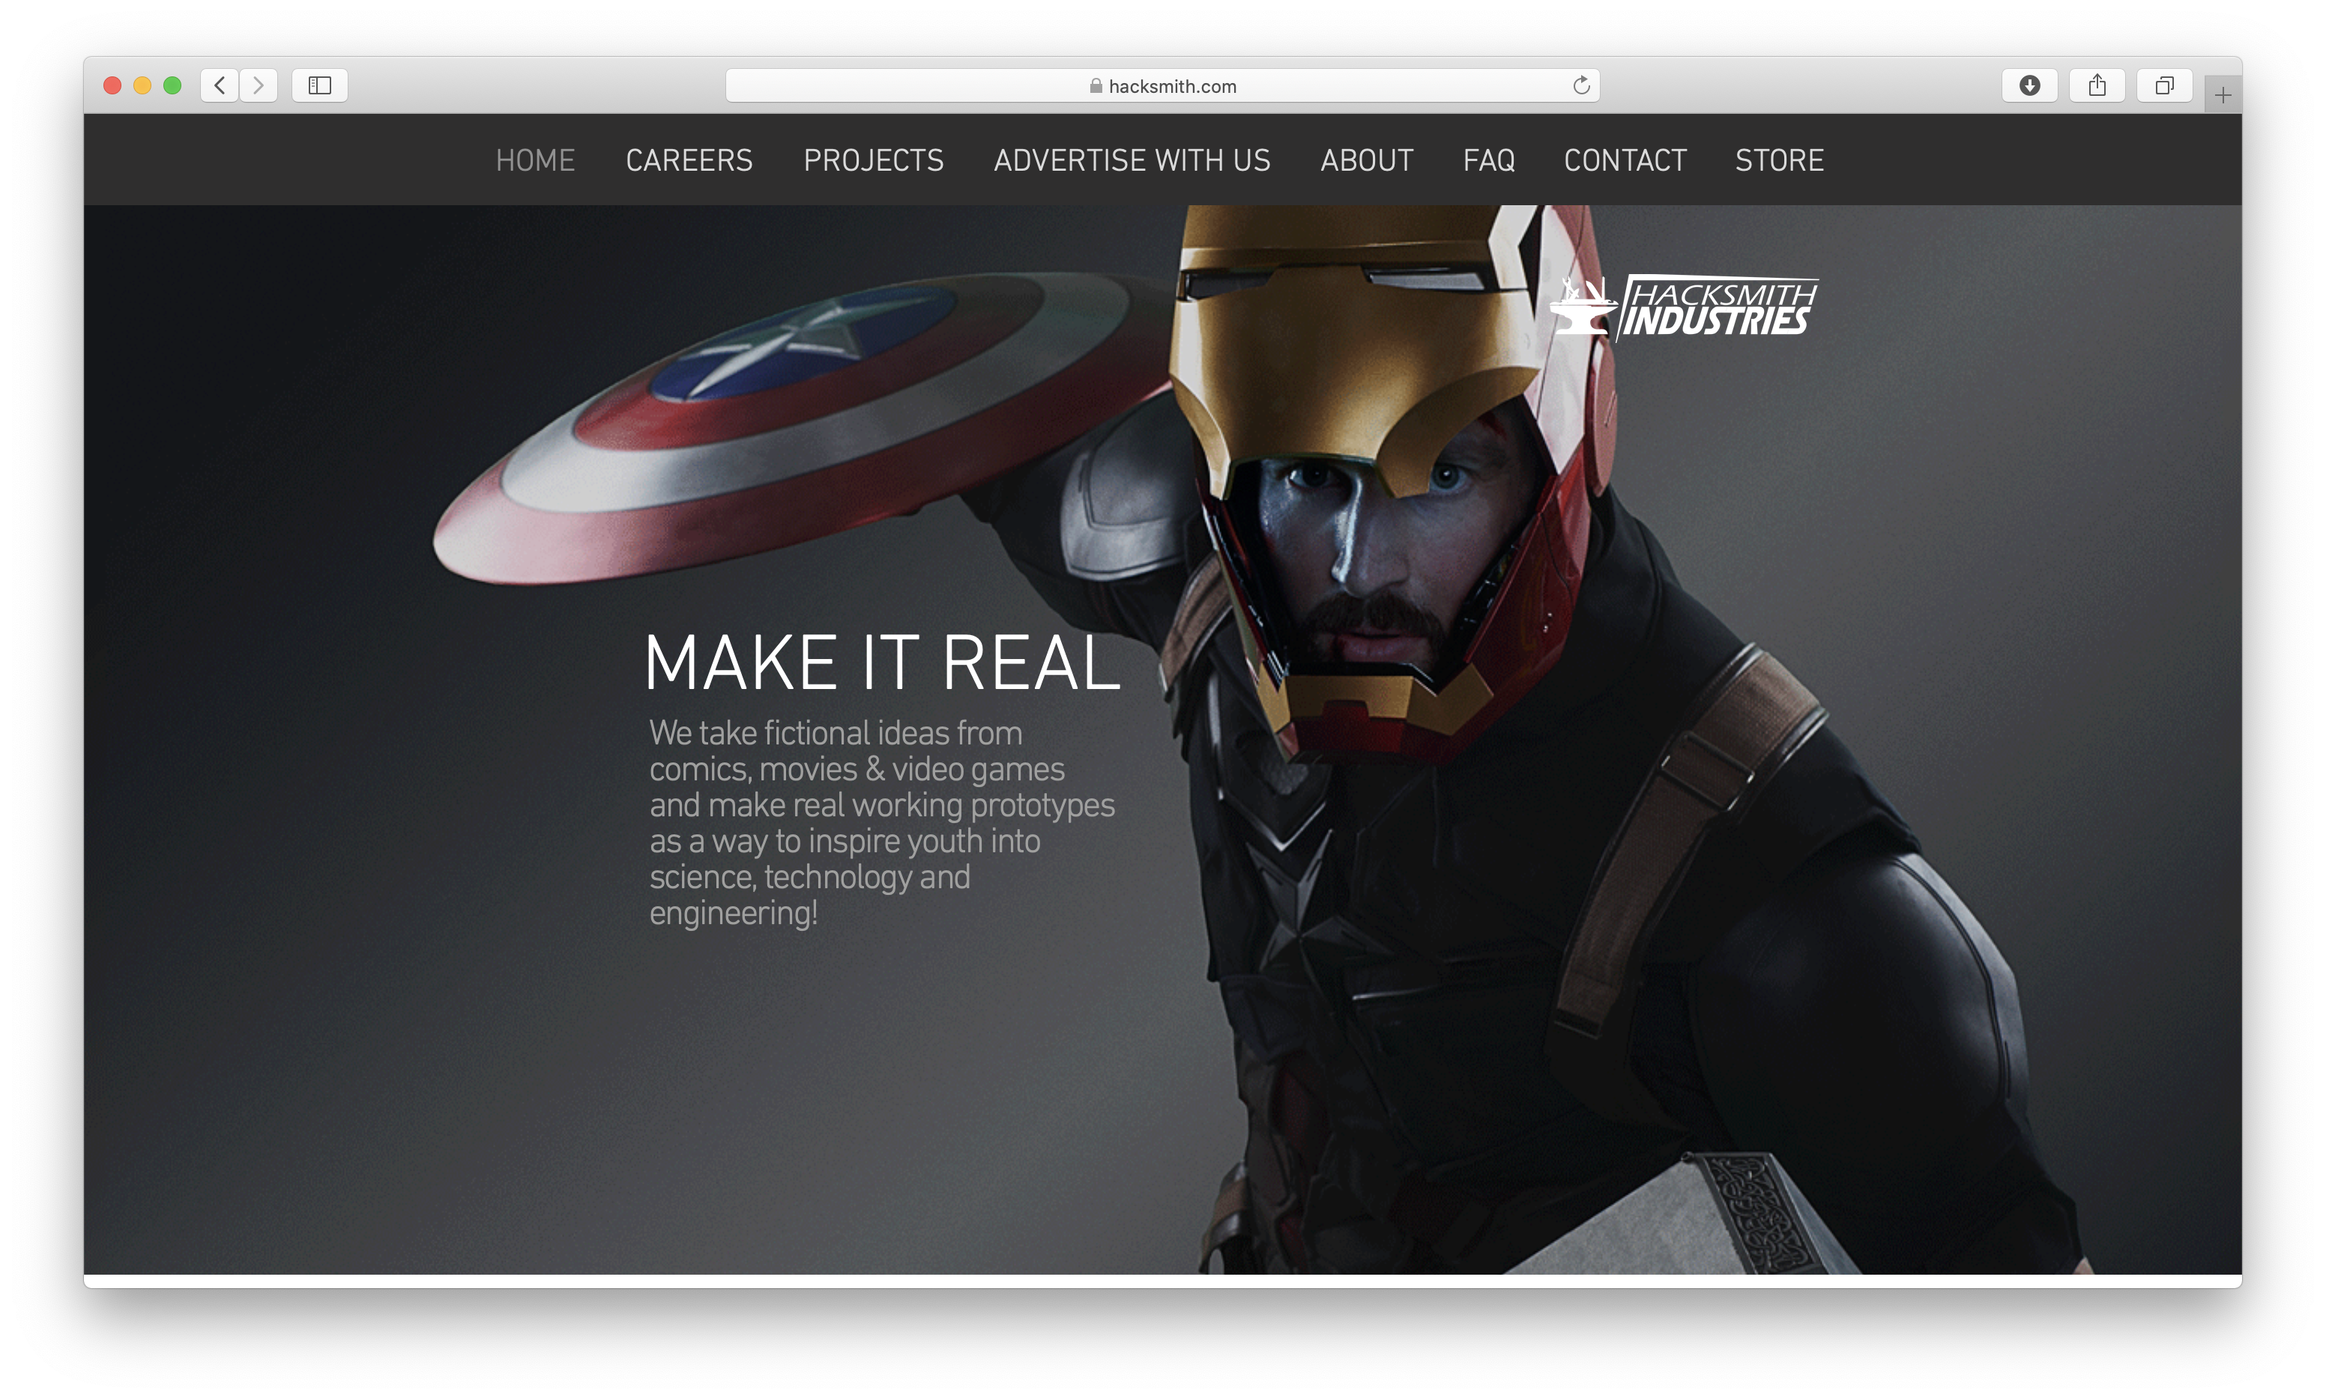
About Hacksmith Industries

Slide 4
Benefits about this career
Personal satisfaction
High salary
Job security
Able to work from home

Slide 5
What everyone thinks programming is about
What actual programming is about

Slide 6
Duties
Responsible to create the working program they needs before the due date
Communicate with my supervisor to modify the program to satisfy their needs

Slide 7
Skills required for the placement
Can learn from online resources
Computer operation skills
Documentation skills
Identifying the problems
Logical thinking
Research skills

Slide 8
Skills I had
Computer operation skills
Logical thinking
Research skills

Slide 9
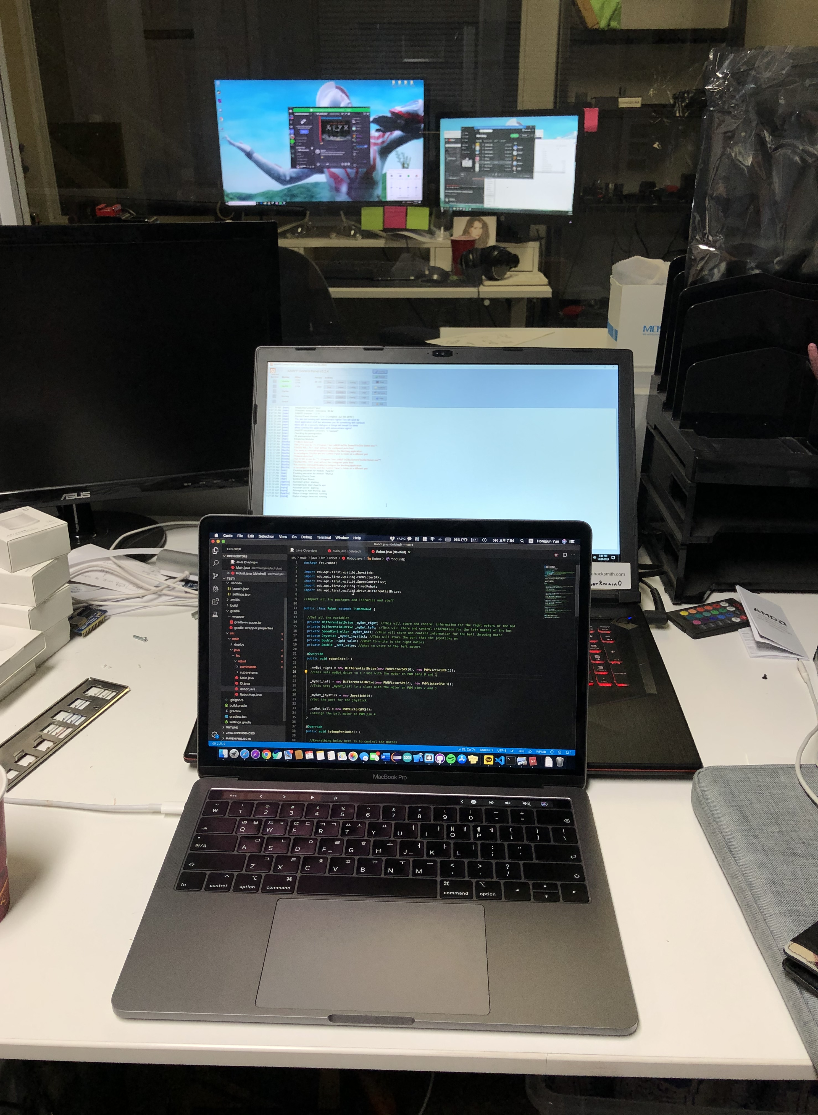
Working environment
IT manger’s assistant
Project-driven
Friendly supervisor

Slide 10
Tasks
Web-based programs
Programs using database

Slide 11
Post-secondary education required
An academic degree about computer
Computer science
Software engineering
Computer engineering
mechatronics

Slide 12
Next step
Apply to university
Work experiences
McMaster Engineering I Coop course

Slide 13
Personal benefits
Able to experience how it is to be in the work environment I want
Can learn the techniques that I need in the workplace
Get a broad outline of what I have to learn in the future to be in that area

